Slide 1
Model Interpretability with LIME
Alec Chapman
IDEAS NLP Core Journal Club
09/10/2019

Slide 2
Agenda
Overview of Interpretability
LIME
Hands-On Example: "Explaining Pneumonia Classification with LIME"
References

Slide 3
Getting set up for the hands-on example
git clone https://github.com/abchapman93/ideas_lime_tutorial
cd ideas_lime_tutorial
pip install -r requirements.txt

Slide 4
Overview of Interpretability

Slide 5
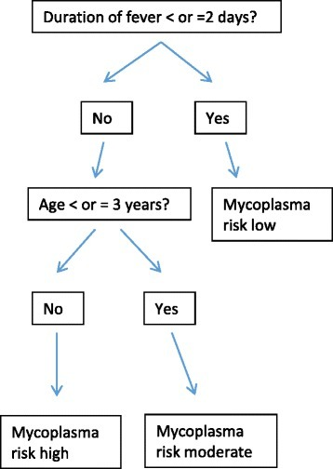
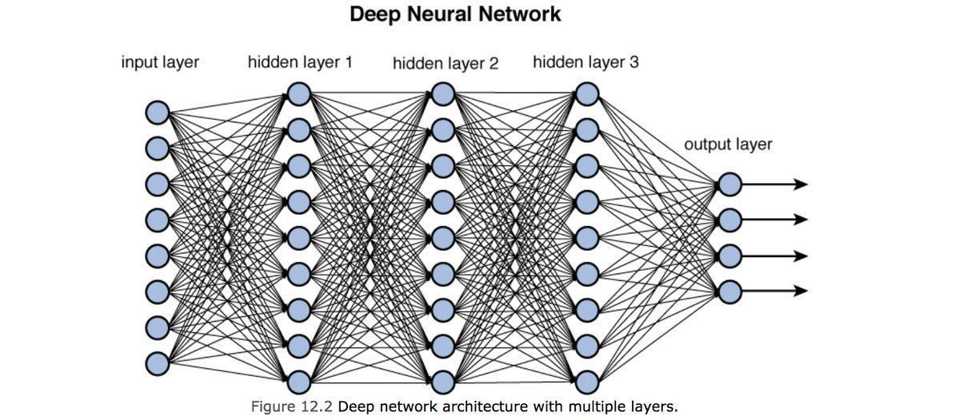
The Black-Box Model
Some models make decisions which can be easily understood by humans
The more complex a model, the harder it is to understand
"Black box"

Slide 6
Problems with Black Box models
Blind trust in the model
Unable to detect:
Bias
Vulnerabilities
Situations where a model may fail
Only learn the "what", don't learn anything new about the problem
“The problem is that a single metric, such as classification accuracy, is an incomplete description of most real-world tasks.” (Doshi-Velez and Kim 2017)

Slide 7
Interpretability
"Interpretability is the degree to which a human can understand the cause of a decision" (Miller)
Provide insight to a decision, teach us about the problem
Should be able to use complex models but still understand their decisions
Interpretability methods offer ways to explain the decisions of complex models

Slide 8
Importance of Interpretability in Clinical Machine Learning
Medicine is high-risk - blind trust isn't enough
Clinical decisions are complex and take into account many factors
New innovations and technology need to be trusted and accepted by the end users (clinicians)

Slide 9
LIME

Slide 10
LIME Algorithm
"Why Should I Trust You?" Explaining the Predictions of Any Classifier [Riberio et. al]
"Local Interpretable Model-agnostic Explanations"
Aims to create explanations which are:
Easy to interpret
Uses specific examples for explanation ("local")
Can use any model ("Model-agnostic")
One of multiple interpretability methods

Slide 11
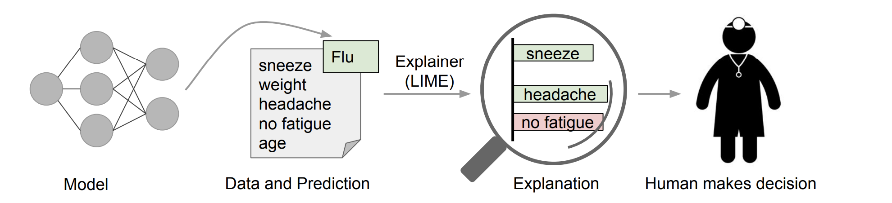

Slide 12
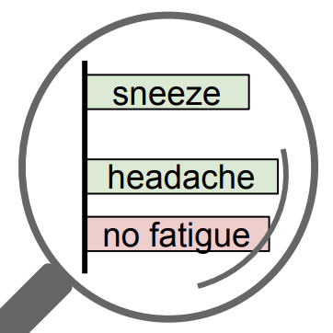
1) Train Black-box model
X
y
Black-box model
instance
sample₀
prob₀
Interpretable
Model
2) Select instance to explain and generate samples
sample₁
prob₁
sample₂
prob₂
3) Train interpretable local model
3) Create explanation by interpreting local model
sample₃
prob₃
sample...
prob...
Notes:
Train a black-box model on a task
Choose an instance to explain
Represent instance in an interpretable way
Generate perturbed data samples on local instance
Train an interpretable model
Use interpretable model to generate explanation

Slide 13
1) Train Black-box model
X
y
Black-box model
instance
sample₀
prob₀
Interpretable
Model
2) Select instance to explain and generate samples
sample₁
prob₁
sample₂
prob₂
3) Train interpretable local model
3) Create explanation by interpreting local model
sample₃
prob₃
sample...
prob...
Notes:
Train a black-box model on a task
Choose an instance to explain
Represent instance in an interpretable way
Generate perturbed data samples on local instance
Train an interpretable model
Use interpretable model to generate explanation

Slide 14
1) Train Black-box model
Typical machine learning task
Model can be of any complexity
Neural networks
SVMs
Random Forests, XGBoost
Must generate probabilities (ie., clf.predict_proba(X))

Slide 15
1) Train Black-box model
X
y
Black-box model
instance
sample₀
prob₀
Interpretable
Model
2) Select instance to explain and generate samples
sample₁
prob₁
sample₂
prob₂
3) Train interpretable local model
3) Create explanation by interpreting local model
sample₃
prob₃
sample...
prob...
Notes:
Train a black-box model on a task
Choose an instance to explain
Represent instance in an interpretable way
Generate perturbed data samples on local instance
Train an interpretable model
Use interpretable model to generate explanation

Slide 16
2) Select instance to explain and generate samples
Select any instance to explain (ie., a single document or image)
Represent instance in interpretable way
BOW: simple, understandable representation
Word embeddings: complex and abstract
Generate samples of selected instance
Perturb instance by randomly chaning nonzero elements to 0
In text: taking out words
In images: graying out super-pixels

Slide 17
Example
"impression: focal opacity in the left lower lobe posteriorly"

Slide 18
Example
"impression: focal opacity in the left lower lobe posteriorly"
impression: focal opacity in the left lower lobe posteriorly

Slide 19
Example
"impression: focal opacity in the left lower lobe posteriorly"
impression: focal opacity in the left lower lobe posteriorly
impression: focal opacity in the left lower lobe posteriorly
impression: focal opacity in the left lower lobe posteriorly
impression: focal opacity in the left lower lobe posteriorly

Slide 20
1) Train Black-box model
X
y
Black-box model
instance
sample₀
prob₀
Interpretable
Model
2) Select instance to explain and generate samples
sample₁
prob₁
sample₂
prob₂
sample₃
prob₃
3) Train interpretable local model
3) Create explanation by interpreting local model
sample...
prob...
Notes:
Train a black-box model on a task
Choose an instance to explain
Represent instance in an interpretable way
Generate perturbed data samples on local instance
Train an interpretable model
Use interpretable model to generate explanation

Slide 21
Training the Explaining Model
Perturbed samples become dataset
Samples are weighted by fidelity to original instance (how similar they are)
Use blackbox models to predict probabilities for each sample
New samples and the probabilities are used to train interpretable model
Model can then be used to create an explanation for this instance

Slide 22
Instance | Black-box P(pneumonia) | Weight
impression: focal opacity in the left lower lobe posteriorly | 0.8 | 9/9
impression: focal opacity in the left lower lobe posteriorly | 0.85 | 7/9
impression: focal opacity in the left lower lobe posteriorly | 0.4 | 6/9
impression: focal opacity in the left lower lobe posteriorly | 0.99 | 5/9
impression: focal opacity in the left lower lobe posteriorly | 0.17 | 3/9

Slide 23
1) Train Black-box model
X
y
Black-box model
instance
sample₀
prob₀
Interpretable
Model
2) Select instance to explain and generate samples
sample₁
prob₁
sample₂
prob₂
3) Train interpretable local model
sample₃
prob₃
3) Create explanation by interpreting local model
sample...
prob...
Notes:
Train a black-box model on a task
Choose an instance to explain
Represent instance in an interpretable way
Generate perturbed data samples on local instance
Train an interpretable model
Use interpretable model to generate explanation

Slide 24
Generate an explanation
Use the interpretable model to explain this document (ie., the weights of the)
Example:
Sentences with "opacity", "lobe" generated a higher chance of pneumonia
Sentences with "impression:" generated a lower chance
"Opacity" and "lobe" would have positive weights, "impression:" would have lower
Negative
Positive
opacity
Impressions:
lobe

Slide 25
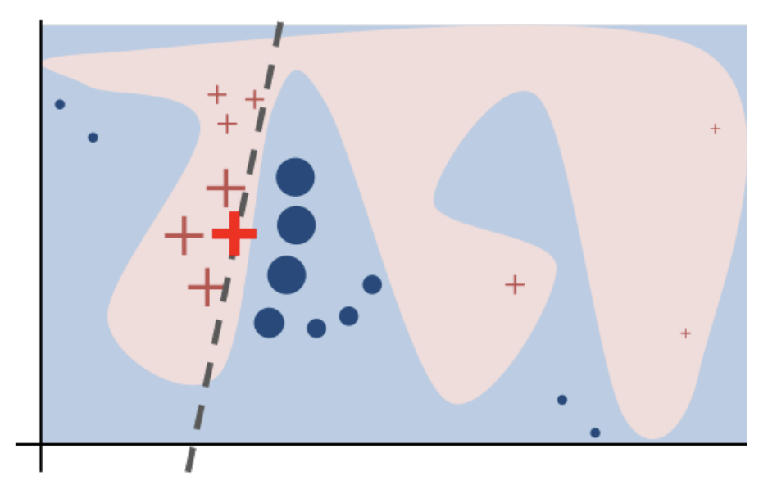
Notes:
Black-box model decision function: blue/pink
Bold cross: instance being explained
Other crosses: sampled instances, weighted by proximity
Labels: predictions of black-box model
Dashed line: learned explanation. Is faithful locally, but not globally

Slide 26
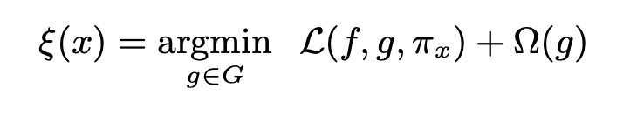
Formal Definition
ξ(x) - explanation for instance x
g - interpretable model used for explanation
G - family of interpretable models
L - loss
Ω(g) - model complexity (ie., depth of decision trees
π_{x} - weight of sample instance (fidelity)

Slide 27
Hands-On Example
https://github.com/abchapman93/ideas_lime_tutorial

Slide 28
References
" 'Why Should I Trust You?' Explaining the Predictions of Any Classifier", Riberio et al. https://arxiv.org/pdf/1602.04938.pdf
Interpretable Machine Learning, Molnar. https://christophm.github.io/interpretable-ml-book/
"What Clinicians Want: Contextualizing Explainable Machin e Learning for Clinical End Use", Tonekaboni et al. https://arxiv.org/pdf/1905.05134.pdf

